Slide 1

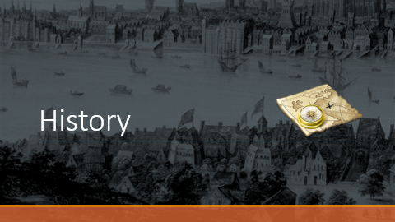






Exchange Works

Slide 2



England
Aleph santos | João borges | Kleber Rodrigues | lucas Henrique
Teacher grazi
Informática III
Etec de Nova Odessa
2017

Slide 3
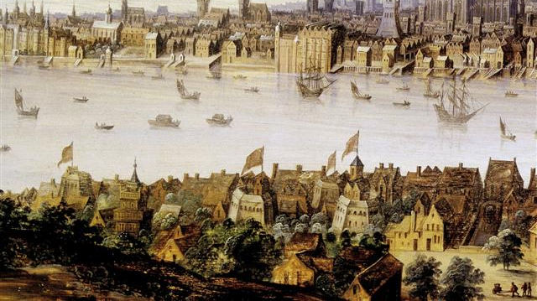

History

Slide 4

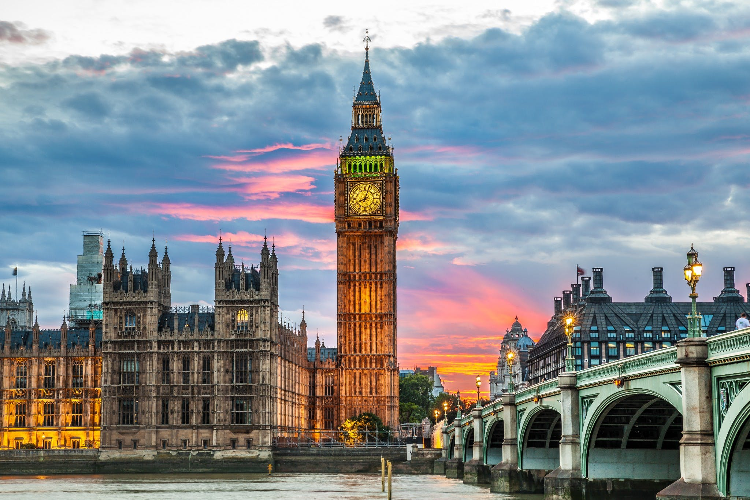
The History
Foundation
Fall of the Empire
Bridge Reconstruction
The catastrophe

Slide 5


Touristic Points

Slide 6
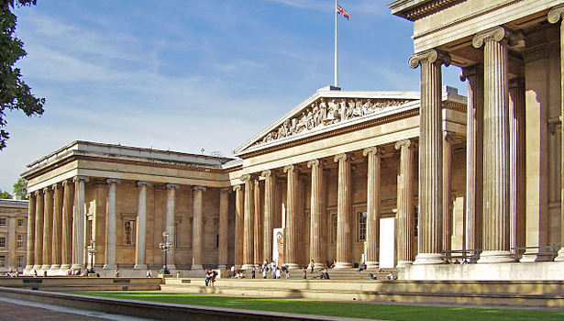
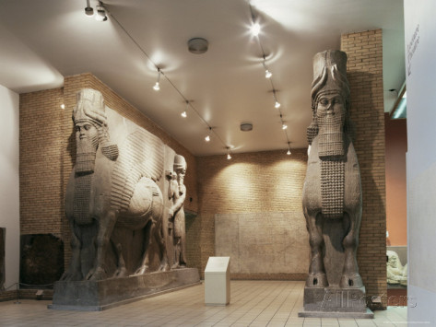
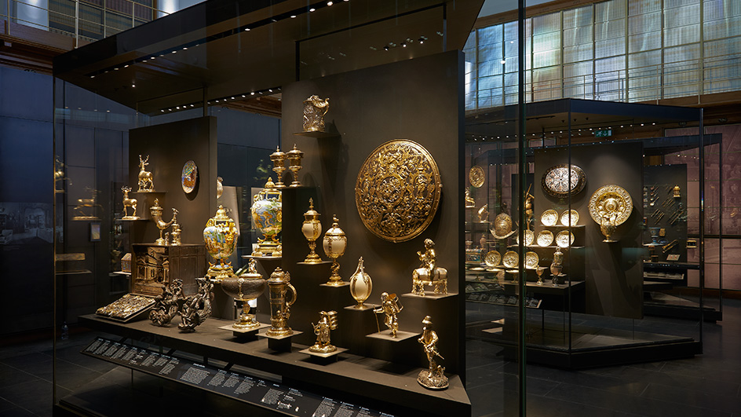
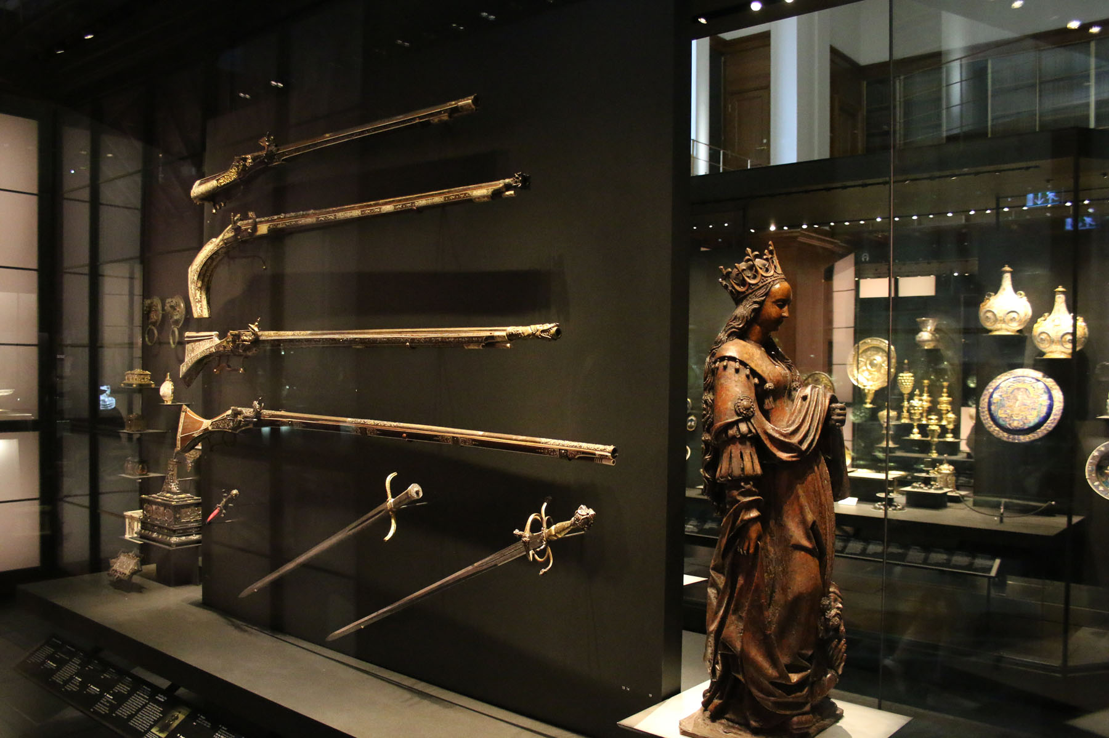

British Museum
6,601,036 *
The British Museum is home to one of the world's largest collections of historical and cultural artefacts. Established in 1753, the museum is now Britain's best-loved attraction.
* 2013

Slide 7
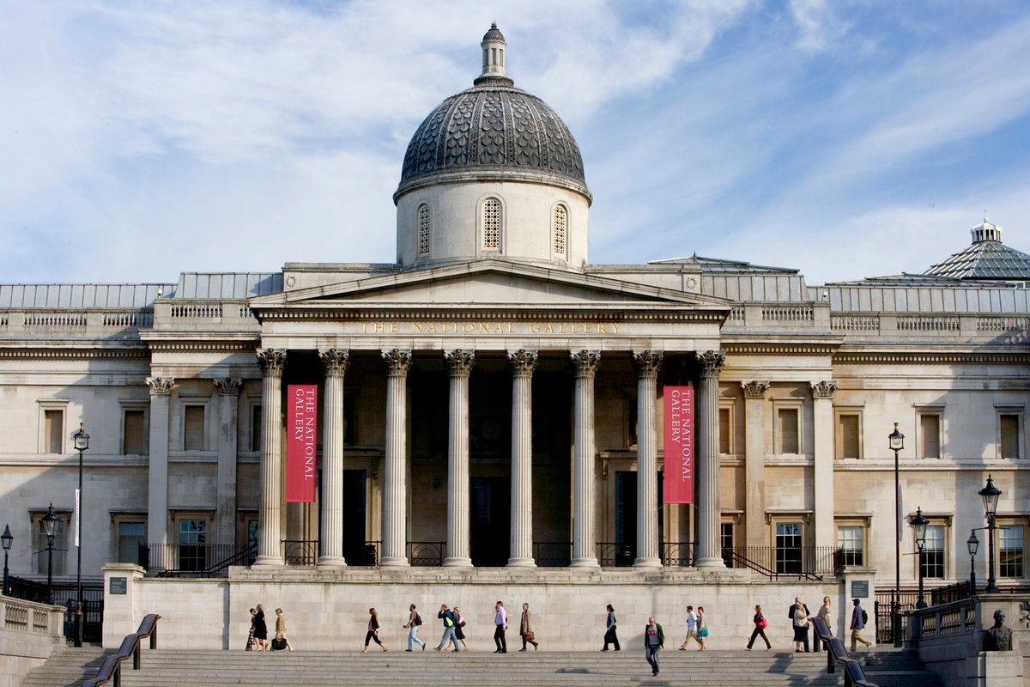
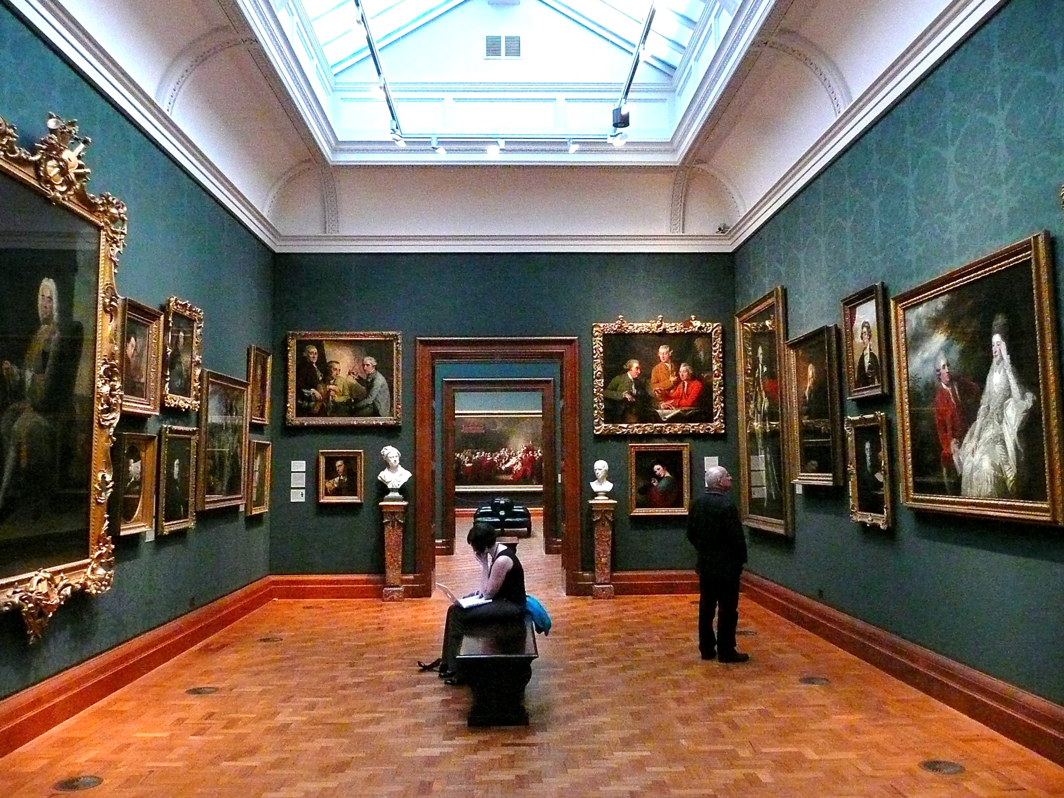
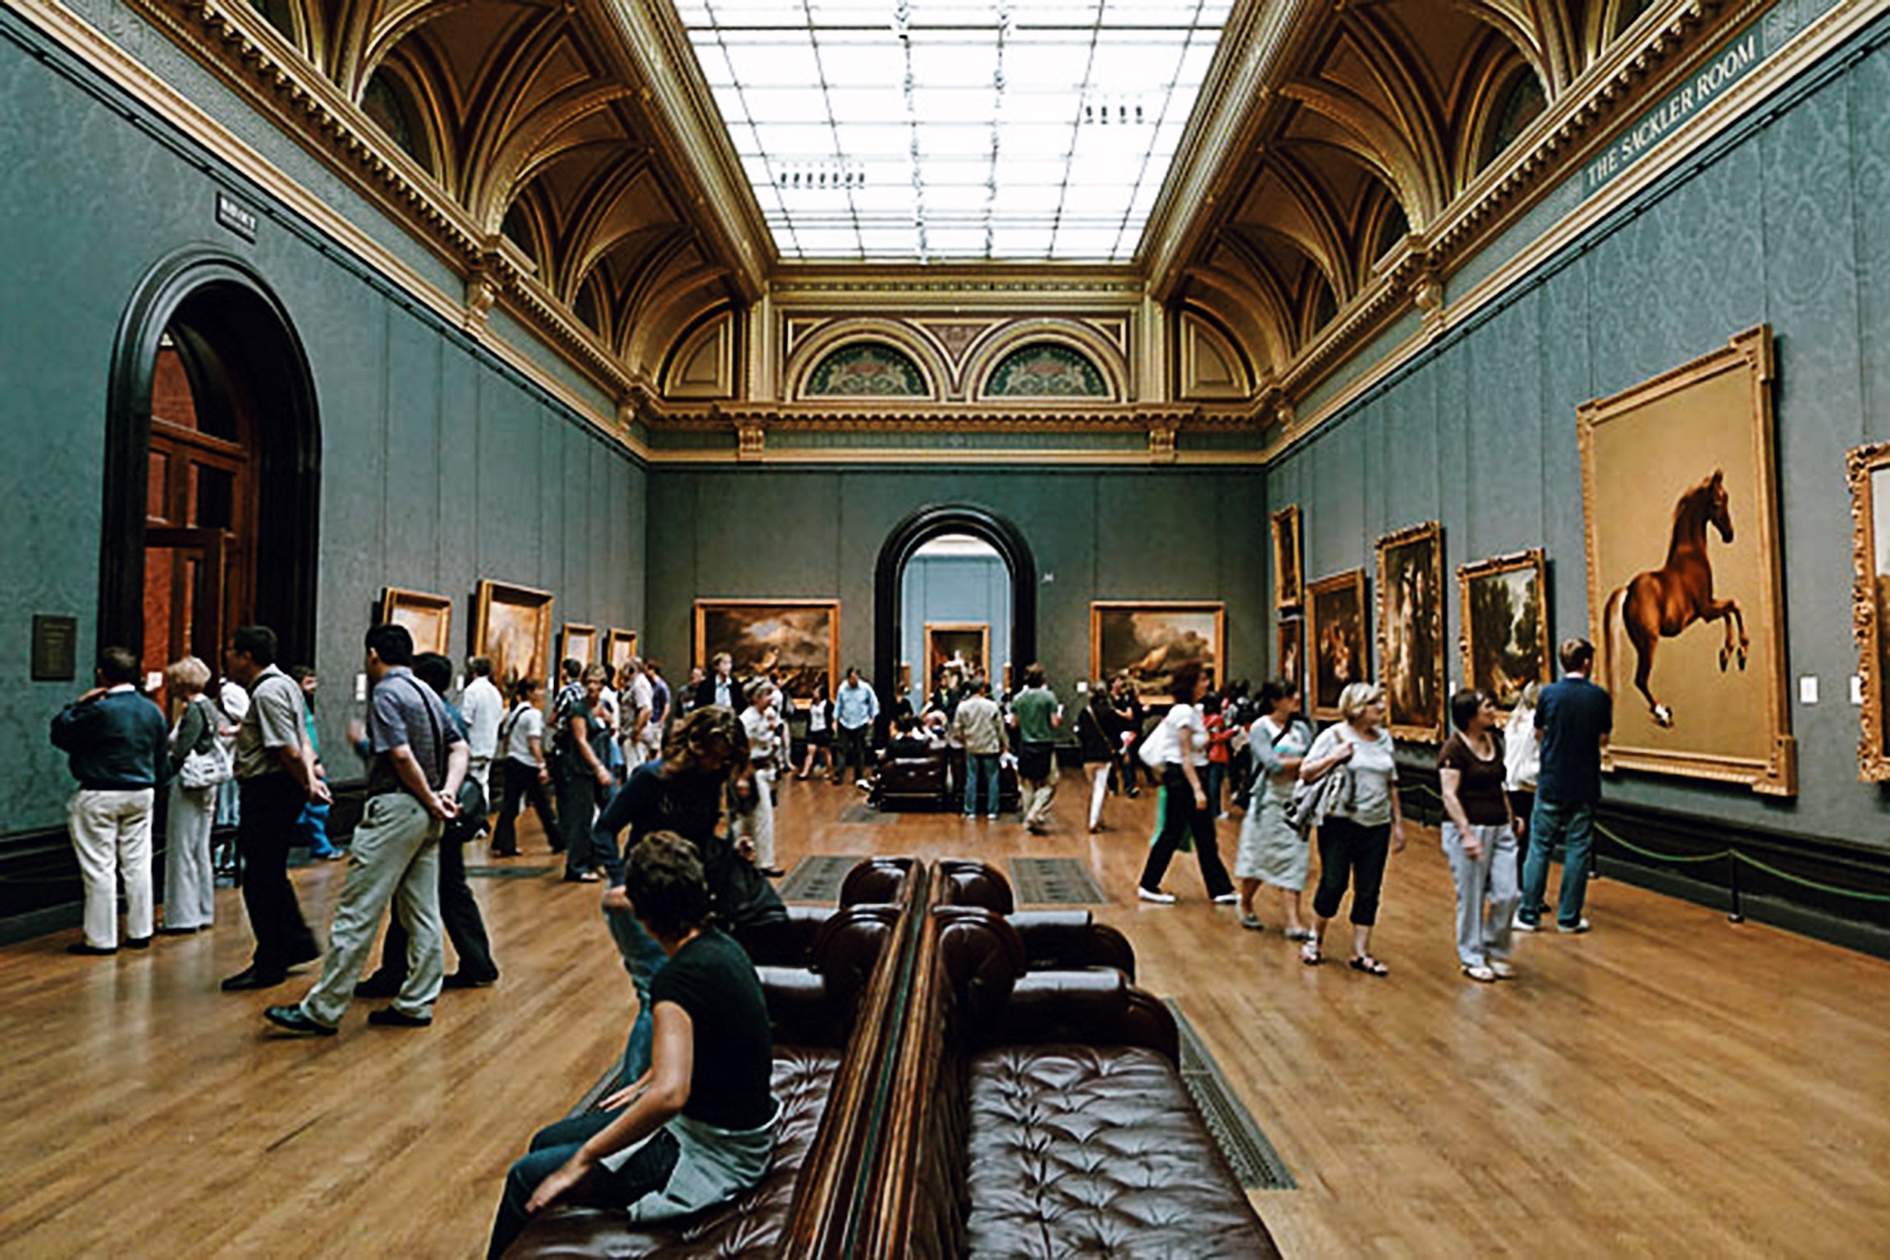
National Gallery
6,031,574 *
The impressive façade of the National Gallery has graced Trafalgar Square since the 1830s. Some 2,300 paintings are housed here, including pieces by Rembrandt and Monet.
* 2013

Slide 8
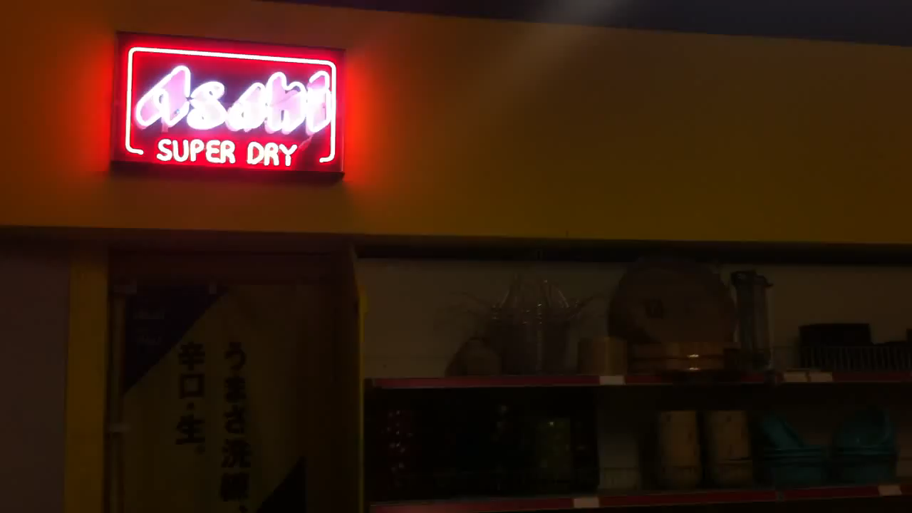
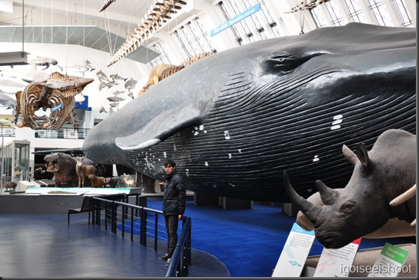
Natural History Museum
5,356,884 *
A series of dinosaur skeletons form the main attraction of the Natural History Museum. Other highlights include an earthquake simulator and a life-size model of a blue whale.
* 2013

Slide 9
Epping Forest
4,400,000 *
Epping forest is London's largest open space. Visitors can explore a number of walking trails and Queen Elizabeth's Hunting Lodge - a timber-framed house from Tudor times.
* 2013

Slide 10
Stonehenge
1,241,296 *
The ancient standing stones of Stonehenge were build between 3000 and 2000 BC. Their original purpose has never been determined, and they remain shrouded in mystery.
* 2013

Slide 11
Houses of Parliament
1,041,000 *
The houses of parliament represent the seat of British democracy. The institution has a rich history, from the foiled Gunpowder Plot to the assassination of Spencer Perceval.
* 2013

Slide 12

Money

Slide 13
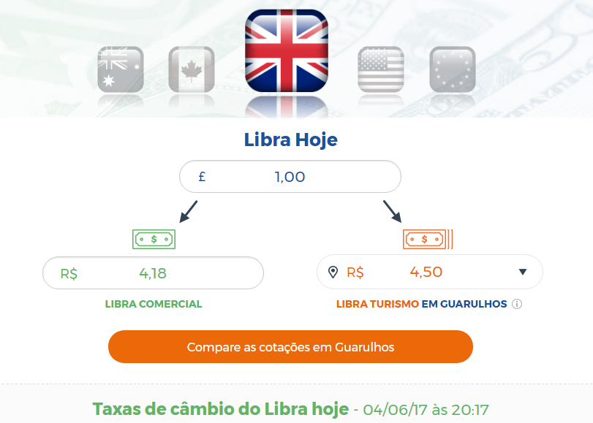
£ - quid
British Pound(£) and de cents is penny our pence
There are Money bills of £5, £10, £20 and £50
Coins of 1p, 2p, 5p, 10p, 20p, 50p

Slide 14

Season

Slide 15
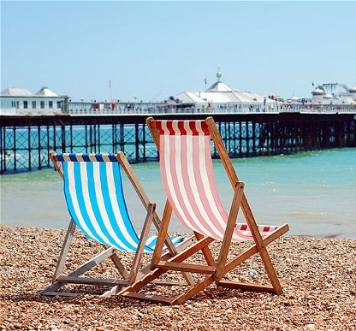
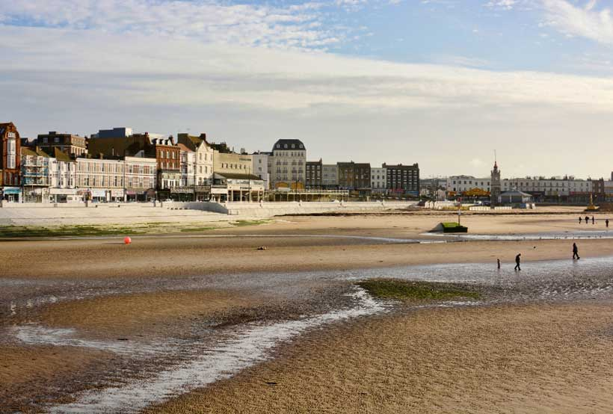
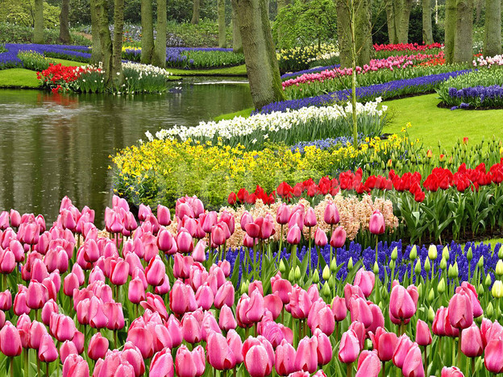
Best Seasons
The Bests seasons is Spring and Summer.
May, June, July and August

Slide 16


English Schools

Slide 17

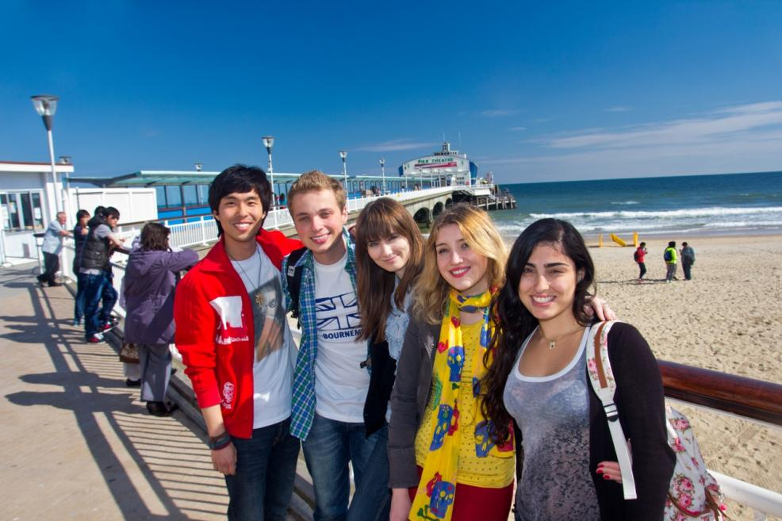
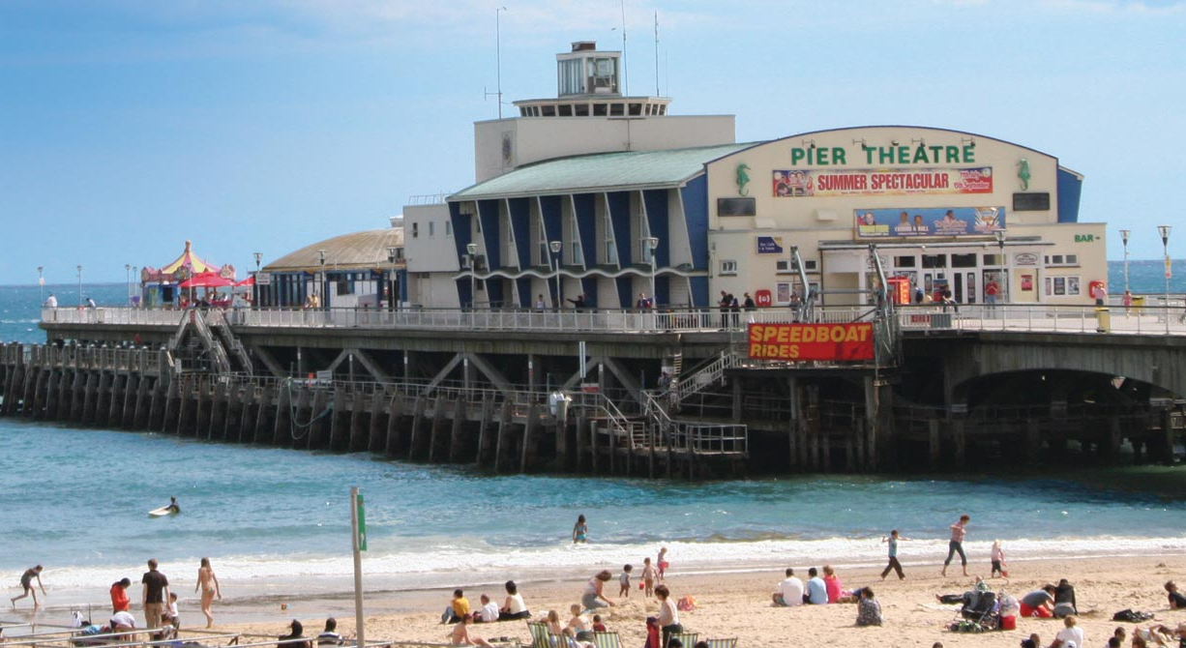
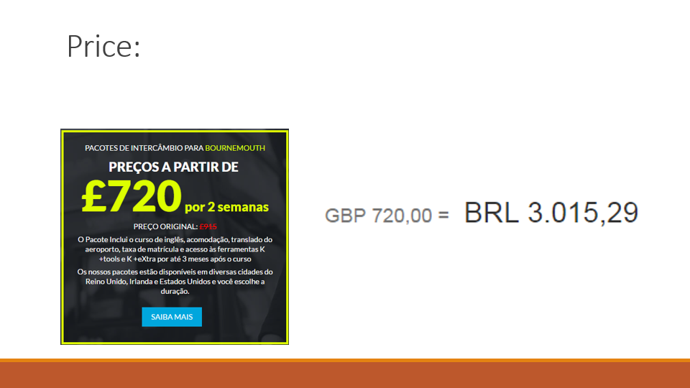
English school Bournemouth

Slide 18

Price:

Slide 19

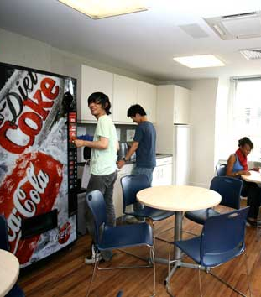
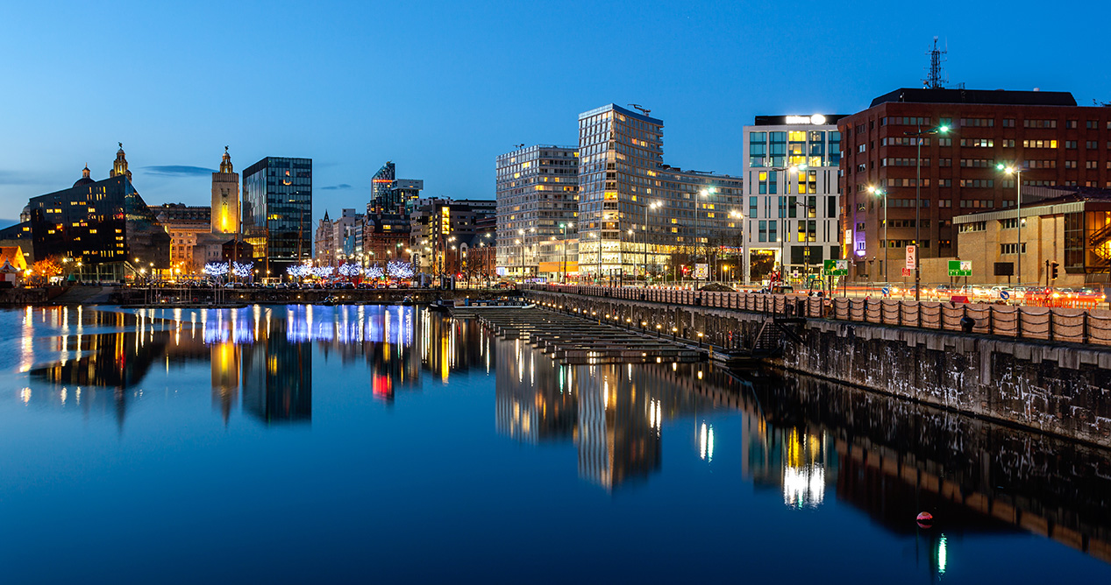
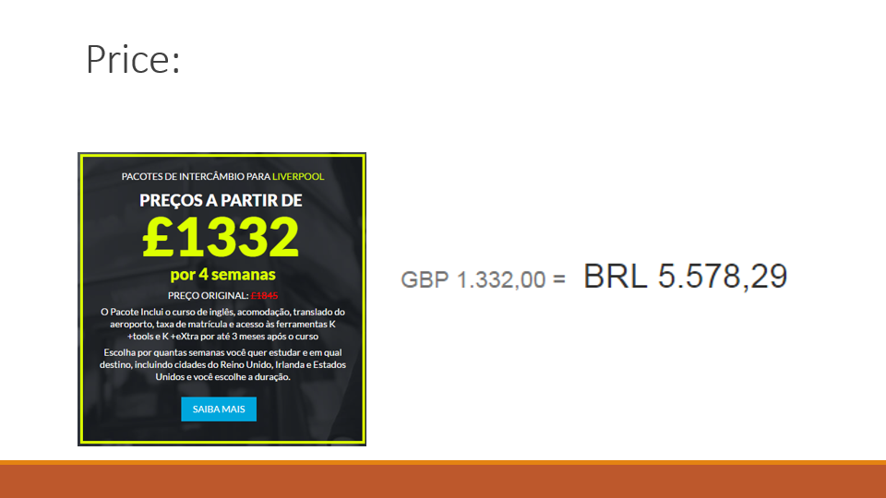
English school
Liverpool

Slide 20

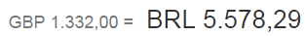
Price:

Slide 21
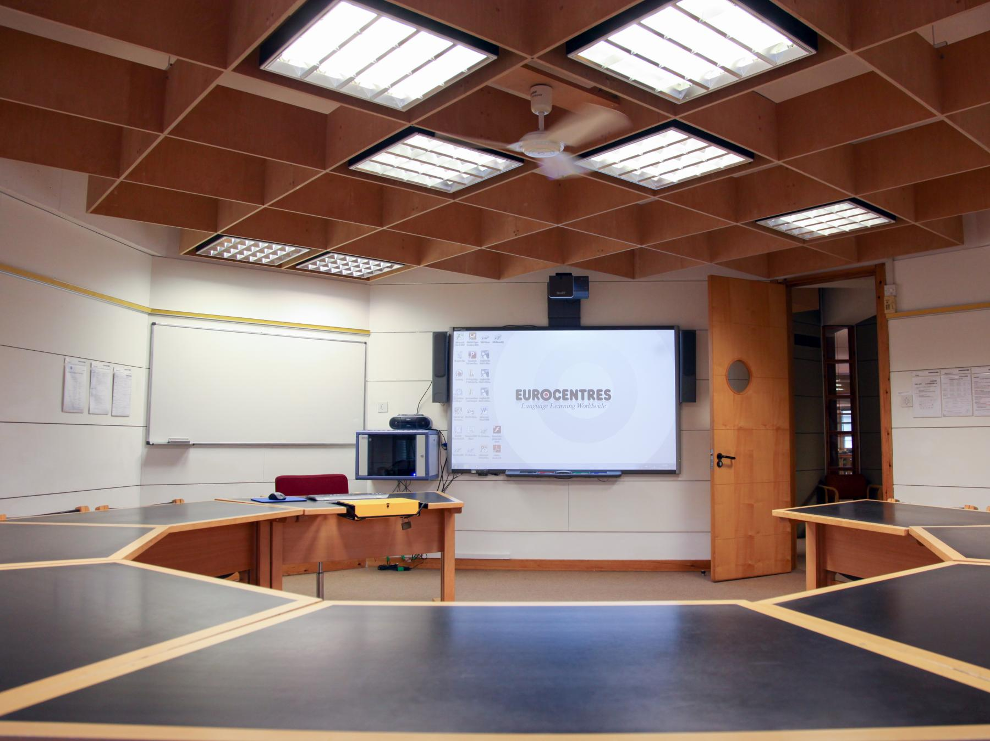
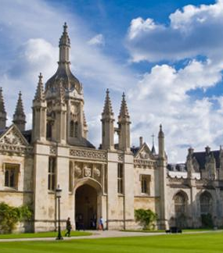
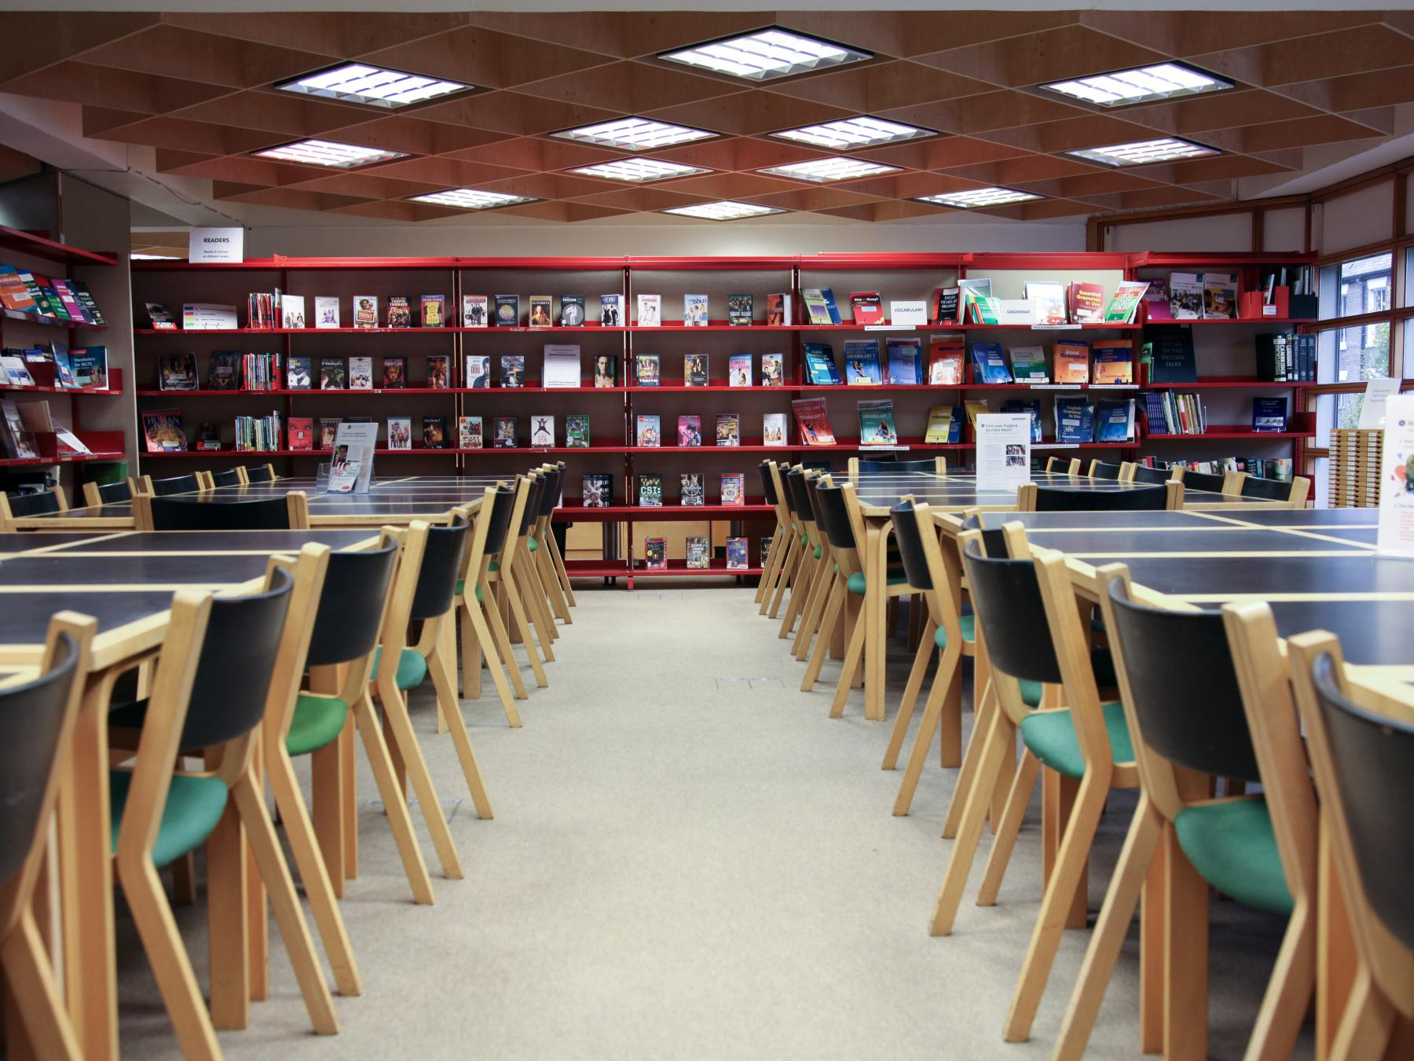
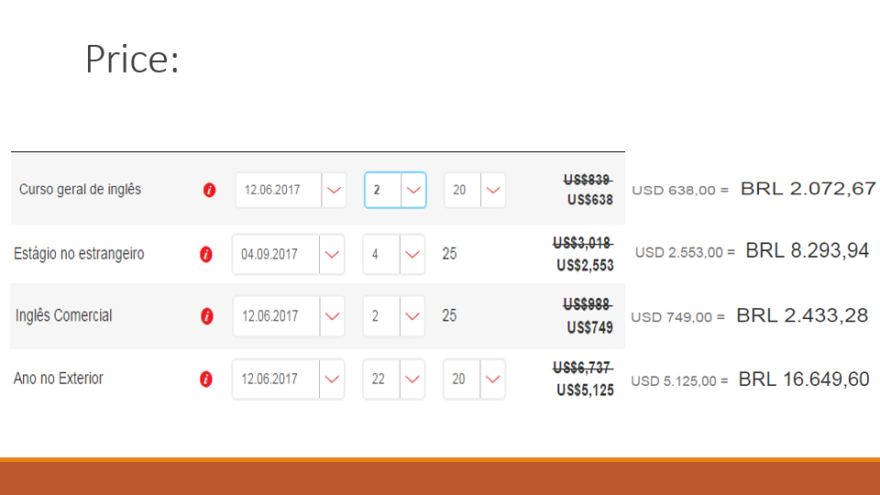
English school Eurocentres Cambridge

Slide 22
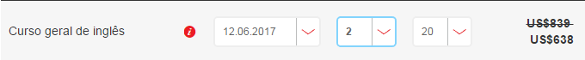
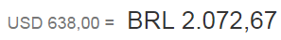
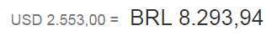
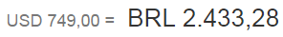
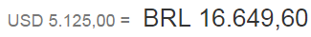
Price:

Slide 23

Accommodation

Slide 24
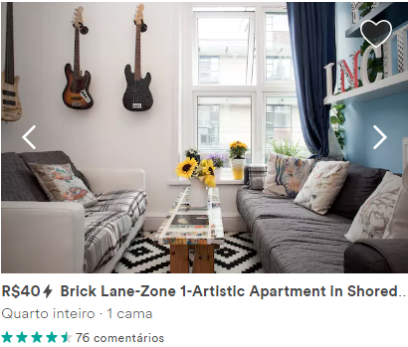

Apartment

Slide 25


Slide 26
References
EUROCENTRES
https://www.eurocentres.com/pt/escola-de-idiomas-cambridge
KAPLAN INTERNATIONAL
https://www.kaplaninternational.com/br/reino-unido/liverpool/escola-ingles-liverpool
https://www.kaplaninternational.com/united-kingdom/bournemouth/english-school-bournemouth
DAILY MAIL
http://www.dailymail.co.uk/travel/travel_news/article-2986259/Epping-Forest-receives-4-4million-visitors-Brighton-Pier-10-site-outside-London-UK-s-popular-visitor-attractions-revealed.html
GURI IN LONDON
https://www.youtube.com/channel/UCTQMfDO949XQIpSMxDkuB7w
INGLATERRA BRASIL
https://inglaterrabrasil.com.br/perguntas-frequentes/moeda/
ENTRE IR E VIR
http://entreirevir.com/2012/08/31/londres-e-suas-estacoes-do-ano/
MAPA DE LONDRES
https://mapadelondres.org/quando-viajar-para-londres/

